Slide 1



Science Curriculum Conferences
Lower Grades (Pre-K to Grade 2) Mrs. Schreier
Upper Grades (Grades 3 to 5) Mrs. Yosevitz

Slide 2

Curriculum
Harcourt Science
Amplify Science
Mystery Science
Experiments, hands on investigations
ELA/Math infusion when applicable
STEM Activities

Slide 3
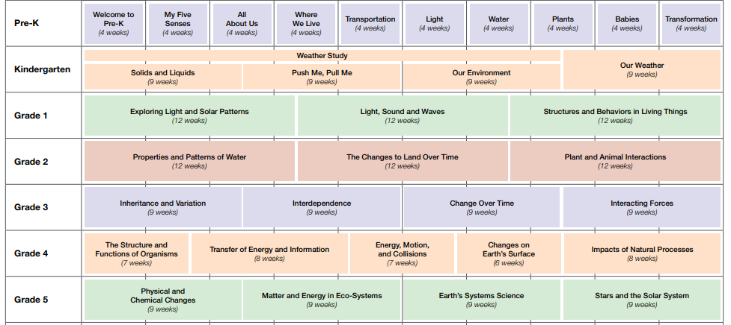
Topics: Earth, Life and Physical Sciences
Link: Scope and Sequence

Slide 4


Homework Policy
Distributed Fridays and returned on Monday (or provided due date)
Given out by classroom teacher and collected in homeroom
4th Grade: As the state exam approaches, homework may increase.

Slide 5

Notebook/Classwork Policy
Collected at random
Checked for neatness, completion of work, and accuracy
Incomplete assignments will be sent home or completed at lunch if necessary

Slide 6
School wide Grading Policy
40% Assessments
20% Participation and Effort
20% Homework
20% Class work

Slide 7


Online Information
Lower Grades
ps65earlychildhoodscience.weebly.com
Upper Grades
ps65sciencelab.weebly.com
OR Visit http://www.ps65.org and follow our links under the “program” tabs

Slide 8



Contact
nshreier@schools.nyc.gov
dyosevitz@schools.nyc.gov
Email:
Call the office- the secretary will leave a note in our mailbox
Send a note to school (your child’s home room teacher will deliver it)

Slide 9
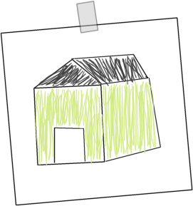
Science at Home
Check out science related
books from the library
Talk about science news you hear in the media
Play games online!
Ask what they learned in Science (new words, fun experiments, interesting readings, educational video clips, etc.)

Slide 10

Donations
Always welcomed, but not mandatory!
Paper towels
Hand sanitizer
Baby wipes (unscented/sensitive skin)
Hand soap
Tissues
Copy paper
Ziploc bags (sandwich and gallon sized)
Clean baby food jars
Pencils
Loose leaf

Slide 11


